Slide 1

Web Development & Design Foundations with HTML5
Tenth Edition
Chapter 4
Visual Elements and Graphics
Copyright © 2021, 2019, 2017 Pearson Education, Inc. All Rights Reserved

Slide 2
Learning Outcomes (1 of 2)
In this chapter, you will learn how to ...
Create and format lines and borders on web pages
Apply the image element to add graphics to web pages
Optimize an image for web page display
Configure images as backgrounds on web pages
Configure images as hyperlinks
Configure visual effects with CSS3 including multiple background images, rounded corners, box shadow, text shadow, opacity, and gradients

Slide 3
Learning Outcomes (2 of 2)
Configure RGBA and HSLA color with CSS3
Use figure and figcaption elements
Use the meter and progress elements
Follow recommended web design guidelines for graphics on web pages

Slide 4
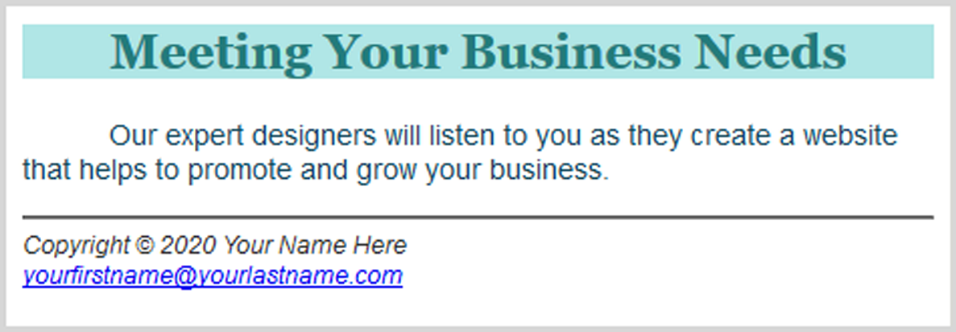
Horizontal Rule Element
Configures a horizontal line
<hr>
Figure 4.1 The <hr> tag configures a horizontal line

Slide 5

CSS border Property
Configures a border on the top, right, bottom, and left sides of an element
Consists of
border-width
border-style
border-color
h2 { border: 2px solid #ff0000 }

Slide 6
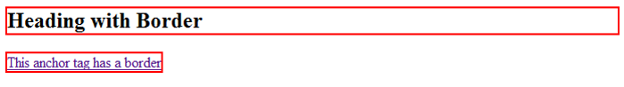
CSS Borders: Block / Inline Elements
Block display element
Default width of element content extends to browser margin (or specified width)
Inline display element
Border closely outlines the element content
h2 { border: 2px solid #ff0000; }
a { border: 2px solid #ff0000; }

Slide 7
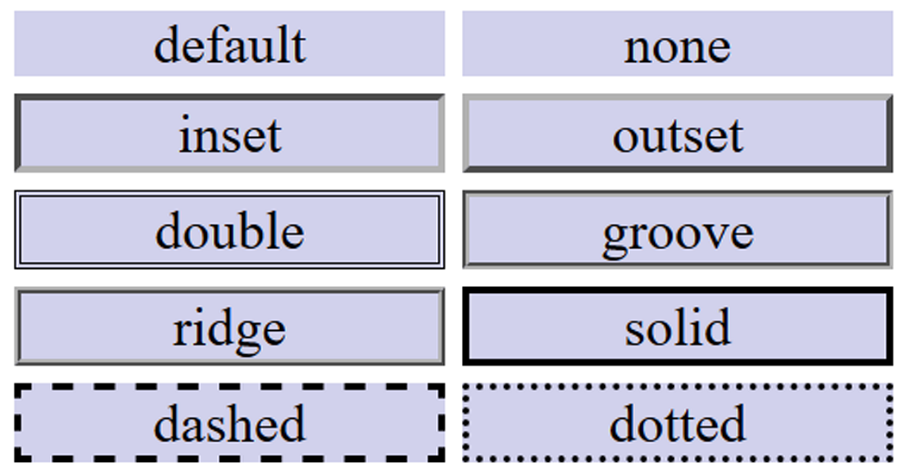
Border Display Can Vary by Browser
Figure 4.2 Examples of the various border-style values rendered by Firefox

Slide 8

Configuring Specific Sides of a Border
Use CSS to configure a line on one or more sides of an element
border-bottom
border-left
border-right
border-top
h2 { border-bottom: 2px solid #ff0000 }

Slide 9

CSS padding Property
Configures empty space between the content of the HTML element and the border
Set to 0px by default
h2 { border: 2px solid #ff0000; padding: 5px; }
No padding property configured:

Slide 10
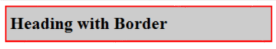
Configure Padding on Specific Sides of an Element
Use CSS to configure padding on one or more sides of an element
padding-bottom
padding-left
padding-right
padding-top
h2 { border: 2px solid #ff0000;
background-color: #cccccc;
padding-left: 5px;
padding-bottom: 10px;
padding-top: 10px; }

Slide 11

CSS padding Property Shorthand: two values
Two numeric values or percentages
first value configures top and bottom padding
the second value configures left and right padding
h2 { border: 2px solid #ff0000;
background-color: #cccccc;
padding: 20px 10px;
}

Slide 12
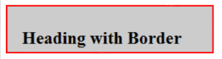
CSS padding Property Shorthand: four values
Four numeric values or percentages
Configure top, right, bottom, and left padding
h2 { border: 2px solid #ff0000;
width: 250px;
background-color: #cccccc;
padding: 30px 10px 5px 20px;
}

Slide 13
Hands-On Practice
h2 { background-color: #B0E6E6;
color: #237B7B;
font-family: Georgia, "Times New Roman", serif;
text-align: center;
border-bottom: 2px dashed #237B7B; }

Slide 14
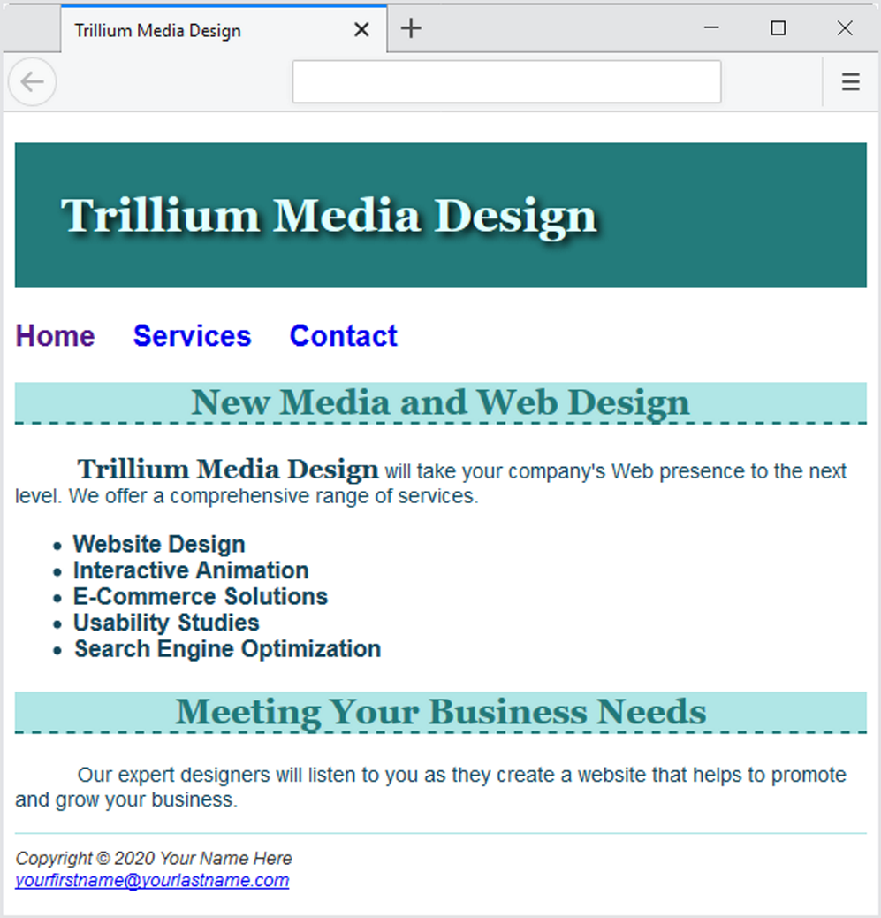
Figure 4.3 CSS border and padding properties add visual interest to the page.

Slide 15
Checkpoint 4.1
Is it reasonable to try to code a web page that looks exactly the same on every browser and every platform? Explain your answer.
When a web page containing the style rules below is rendered in a browser, the border does not display. Describe what is incorrect with the following code:
h2 { background-color: #ff0000
border-top: thin solid #000000
}
True or False? CSS can be used to configure visual elements such as rectangular shapes and lines on web pages.

Slide 16
Types of Graphics (1 of 2)
Graphic types commonly used on web pages:
GIF
JPG
PNG
WebP

Slide 17
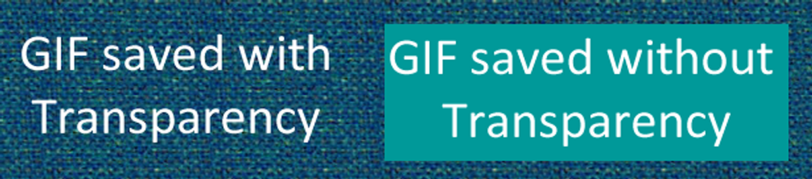
Figure 4.6 Comparison of transparent and nontransparent GIFs
Background color configured to be transparent
Background color – no transparency

Slide 18
Types of Graphics (2 of 2)
Graphics Interchange Format
Best used for line art and logos
Maximum of 256 colors
One color can be configured as transparent
Can be animated
Uses lossless compression
Can be interlaced

Slide 19
JPEG
Joint Photographic Experts Group
Best used for photographs
Up to 16.7 million colors
Use lossy compression
Cannot be animated
Cannot be made transparent
Progressive JPEG – similar to interlaced display

Slide 20

Figure 4.7 A JPEG saved at 80% quality (55KB file size) displays well on a web page

Slide 21
PNG
Portable Network Graphic
Supports millions of colors
Supports multiple levels of transparency (but most browsers do not – so limit to one transparent color for Web display)
Supports interlacing
Uses lossless compression
Combines the best of GIF & JPEG
Well-supported by modern browsers

Slide 22
WebP
https://developers.google.com/speed/webp/
Supports millions of colors
Supports transparency
Uses both lossy and lossless compression
Intended to provide improved compression for GIF and JPG images
Browser support is growing

Slide 23

HTML Image Element
Configures graphics on a web page
<img src="dog.jpg" alt="Dog at computer" height="100" width="100">
src Attribute
File name of the graphic
alt Attribute
Configures alternate text description
height Attribute
Height of the graphic in pixels
width Attribute
Width of the graphic in pixels
Figure 1.3 Who really updated that web page you are viewing?

Slide 24
Accessibility & Images
Required:
Configure the alt attribute
Alternate text content to convey the meaning/intent of the image
NOT the file name of the image
Use alt="" for purely decorative images
Recommended:
If your site navigation uses image links for the main navigation, provide simple text links at the bottom of the page.

Slide 25
Image Link
To create an image hyperlink use an anchor element to contain an image element
<a href="index.html"><img src="home.gif" height="19" width="85" alt="Home"></a>
Some browsers automatically add a border to image links.
Configure CSS to eliminate the border img { border-style: none; }
Home

Slide 26
Thumbnail Image (1 of 2)
A small image configured to link to a larger version of that image.
<a href=“island.jpg”><img src=“small.jpg” alt=“tropical island” width=“200” height=“100”></a>

Slide 27

Thumbnail Image (2 of 2)
Figure 4.7 A JPEG saved at 80% quality (55KB file size) displays well on a web page
Figure 4.9 This small
thumbnail image is only 5KB

Slide 28
Image Optimization
The process of creating an image with the lowest file size that still renders a good quality image—balancing image quality and file size.
Photographs taken with digital cameras are not usually optimized for the Web

Slide 29
Optimize An Image for the Web
Image Optimization
Reduce the file size of the image
Reduce the dimensions of the image to the actual width and height of the image on the web page.
Image Editing Tools:
GIMP https://www.gimp.org/ (FREE!)
Adobe Photoshop
Pixlr
https://pixlr.com/x/ (FREE!)

Slide 30
Choosing Names for Image Files
Use all lowercase letters
Do not use punctuation symbols and spaces
Do not change the file extensions (should be .gif, .jpg, .jpeg, or .png)
Keep your file names short but descriptive
i1.gif is probably too short
myimagewithmydogonmybirthday.gif is too long
dogbday.gif may be just about right

Slide 31
Organizing Your Site
Place images in their own folder
Code the path to the file in the src attribute
<img src=“images/home.gif” alt=“Home” height=“100” width=“200”>

Slide 32
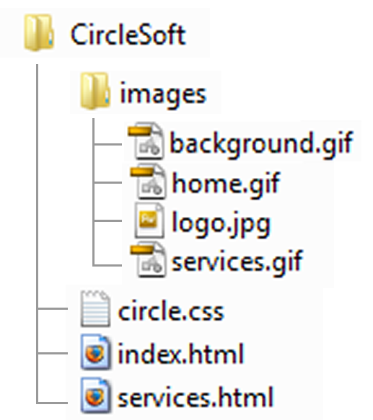
Figure 4.21 A folder named “images” contains the graphic files

Slide 33
HTML5 Figure and Figcaption Elements
Figure Element: contains a unit of content that is self-contained, such as an image, along with one optional figcaption element.
<figure>
<img src= "myisland.jpg" width= "400" height= "400" alt=“Tropical Island Getaway">
<figcaption> Tropical Island Getaway </figcaption>
</figure>

Slide 34
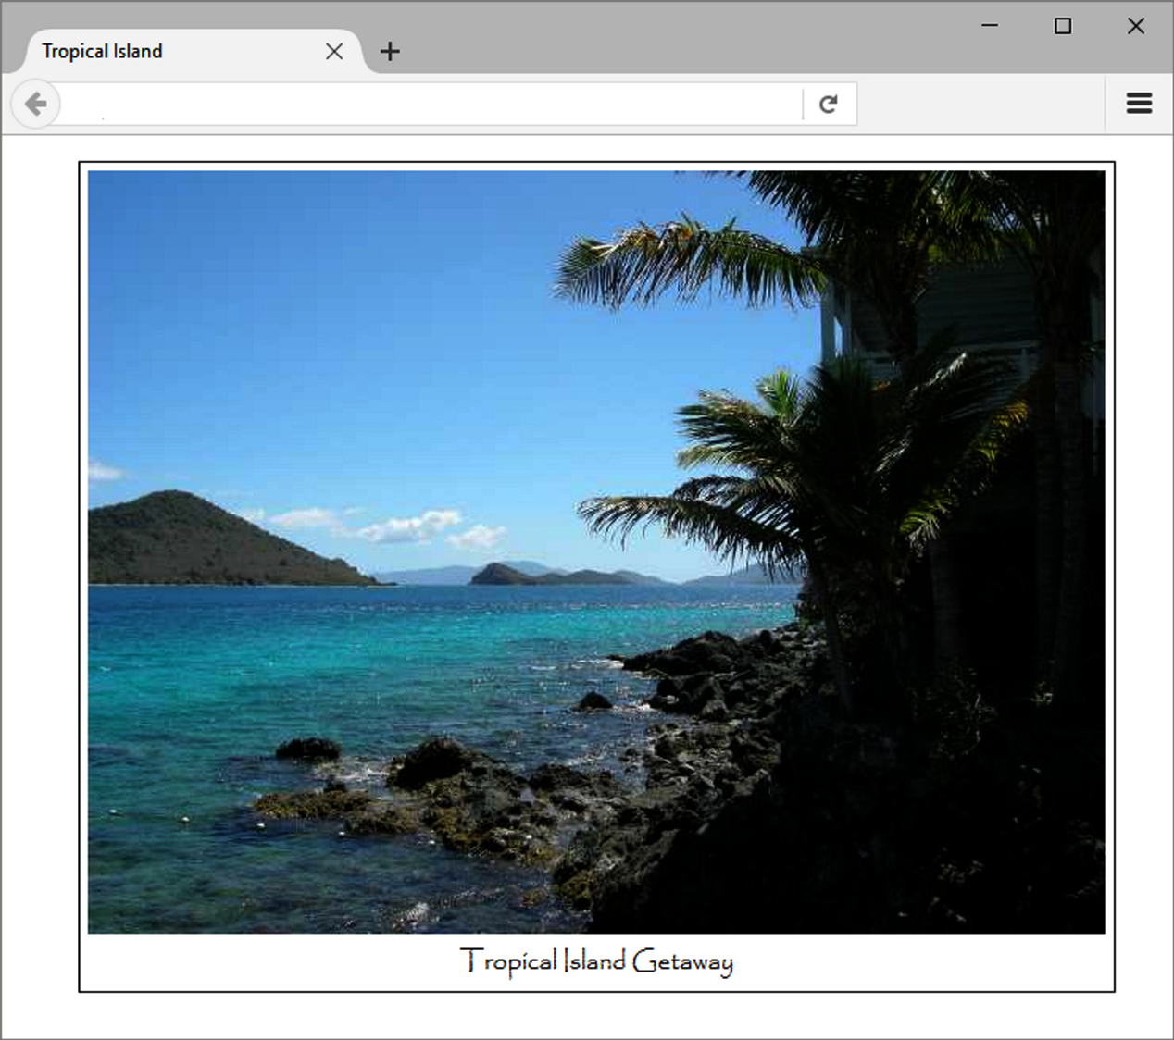
Figure 4.14 The figure and figcaption elements were used in this web page

Slide 35
HTML5 Meter Element
Displays a visual gauge of a numeric value within a known range
<meter value="14417" min="0" max="14417">14417</meter>14,417 Total Visits<br>
<meter value="7000" min="0" max="14417">7000</meter> 7,000 Chrome<br>
<meter value="3800" min="0" max="14417">3800</meter> 3,800 Edge<br>
<meter value="2062" min="0" max="14417">2062</meter> 2,062 Firefox<br>
<meter value="1043" min="0" max="14417">1043</meter> 1,043 Safari<br>
<meter value="312" min="0" max="14417">312</meter> &nbsp;&nbsp; 312 Opera<br>
<meter value="200" min="0" max="14417">200</meter> &nbsp;&nbsp; 200 other<br>

Slide 36
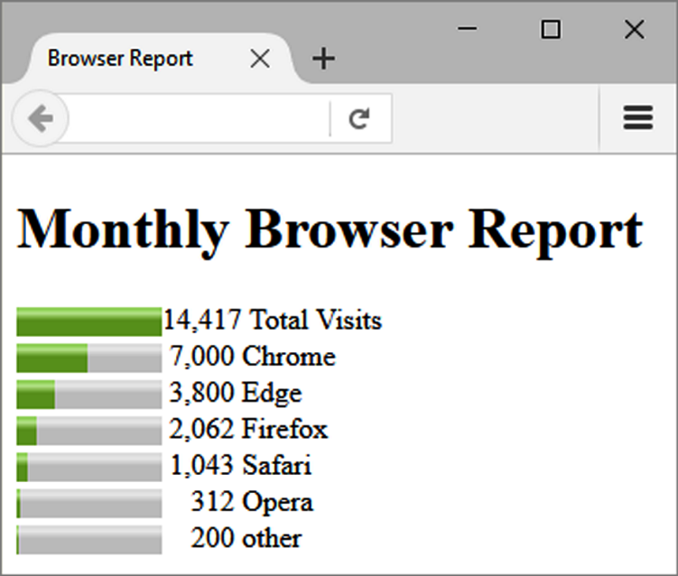
Figure 4.15 The meter element

Slide 37
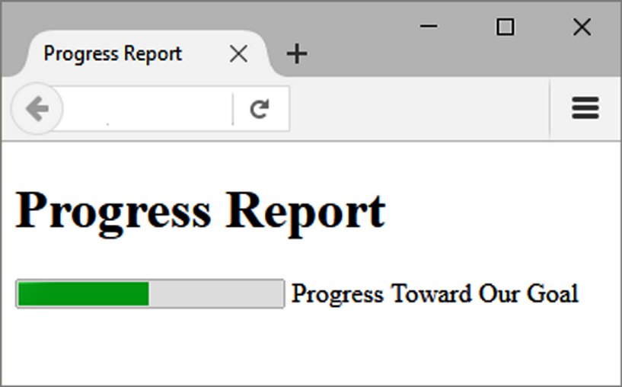
HTML5 Progress Element
Displays a bar that depicts a numeric value within a specified range
<progress value="5000“max="10000">5000</progress> Progress Towards Our Goal
Figure 4.16 The progress element

Slide 38
CSS background-image Property
Configures a background-image
By default, background images tile (repeat)
body { background-image: url(background1.gif); }

Slide 39
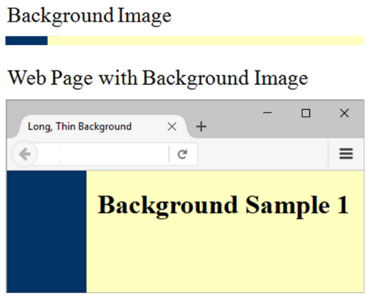
Figure 4.17 A long, thin background image tiles down the page

Slide 40
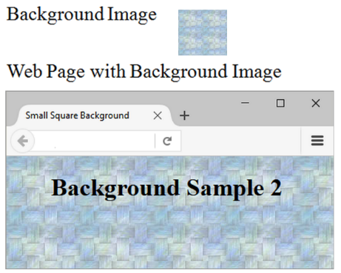
Figure 4.18 A small rectangular background is repeated to fill the web page window

Slide 41
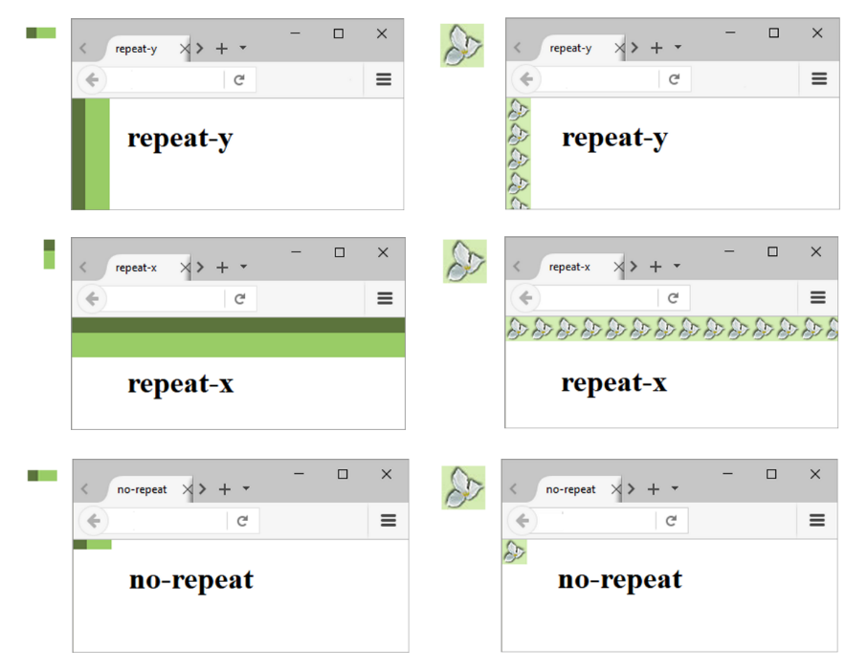
CSS background-repeat Property
Figure 4.19 Examples of the CSS background-repeat property

Slide 42

Using background-repeat
h2 { background-color: #d5edb3;
color: #5c743d;
font-family: Georgia, "Times New Roman", serif;
padding-left: 30px;
background-image: url(flower.gif);
background-repeat: no-repeat;
}
flower.gif:

Slide 43
CSS background-position Property
The default placement of a background image is top left.
The background-position property can change this placement.
h2 { background-image: url(flower.gif);
background-position: right;
background-repeat: no-repeat; }

Slide 44
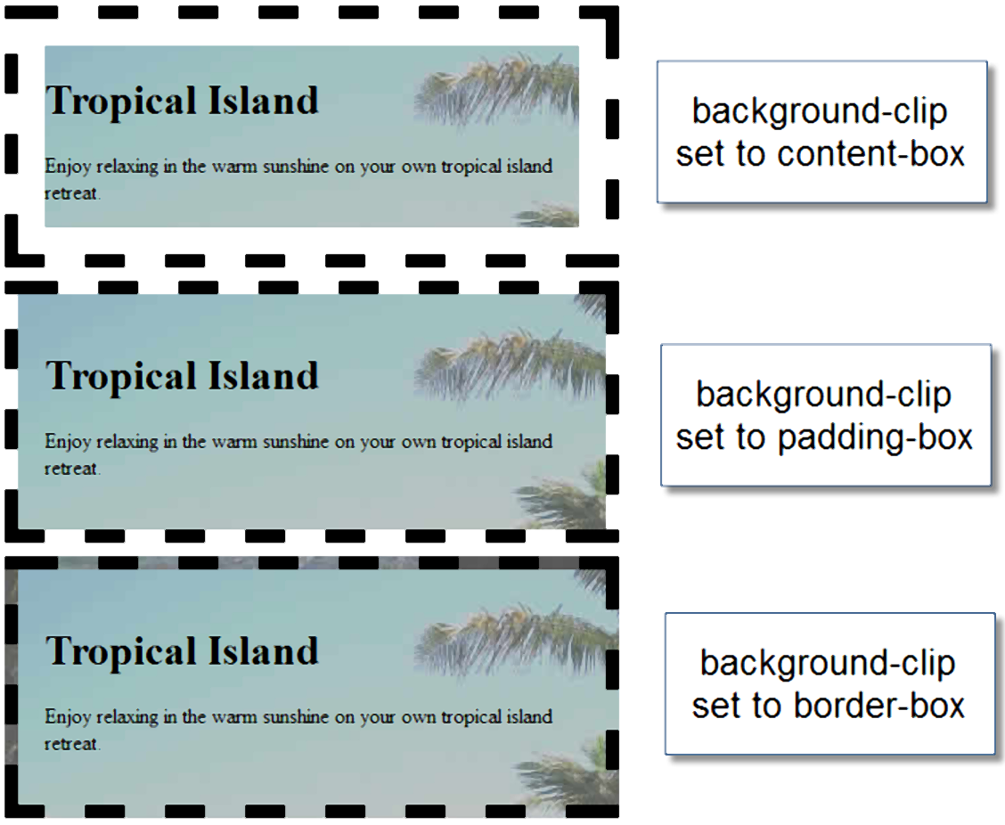
CSS background-clip Property
confines the display of the background image
Figure 4.23 The CSS background-clip property

Slide 45
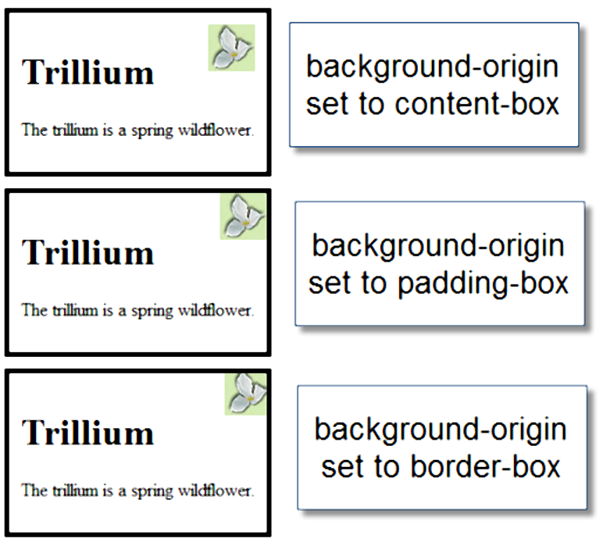
CSS background-origin Property
positions the background image relative to the content, padding or border
Figure 4.24 The CSS background-origin property

Slide 46
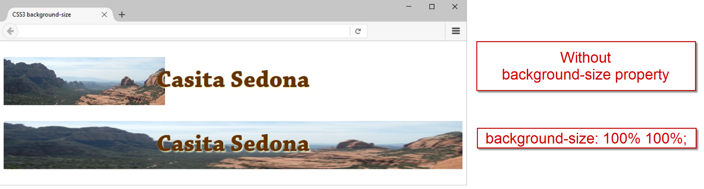
CSS background-size Property
can be used to resize or scale the background image
Figure 4.25 Configuring a background image.

Slide 47
CSS Multiple Background Images
Use the background property to configure multiple background images.
Example:
body {
background: url(coffee.gif) no-repeat left bottom,
url(coffeepour.jpg) no-repeat fixed;
background-size: auto, cover; }

Slide 48
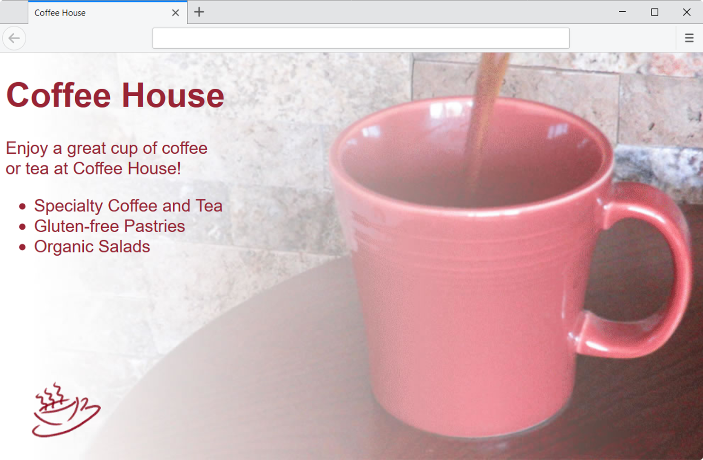
Figure 4.27 The browser displays multiple background images.

Slide 49
Checkpoint 4.2
Describe the CSS to configure a graphic named circle.jpg to display once in the background of all <h1> elements. Code sample CSS to demonstrate this.
Describe the CSS that configures a file named bg.gif to repeat vertically down the background of a web page. Code sample CSS to demonstrate this.
Explain how the browser will render the web page if you use CSS to configure both a background image and a background color.

Slide 50
More About Images
Image Map
Favorites Icon
CSS Sprites
Sources for Graphics
Guidelines for Using Images
Accessibility & Visual Elements

Slide 51
Image Map (1 of 2)
map element
Defines the map
area element
Defines a specific area on a map
Can be set to a rectangle, circle, or polygon
href Attibute
shape Attribute
coords Attribute

Slide 52
Image Map (2 of 2)
<map name="boat" id="boat">
<area href="http://www.fishingdoorcounty.com" shape="rect" coords="24, 188, 339, 283" alt="Door County Fishing">
</map>
<img src="fishingboat.jpg" usemap="#boat" alt="Door County“ width="416" height="350">

Slide 53
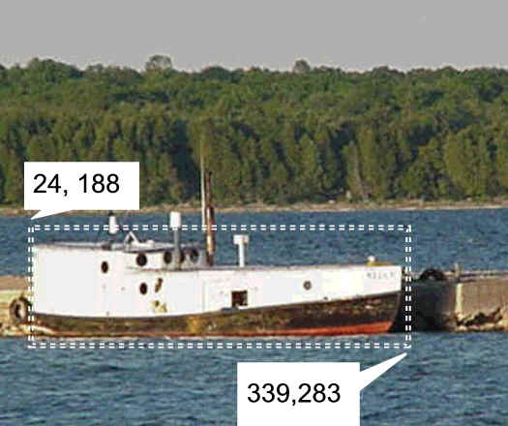
Figure 4.29 Sample image map

Slide 54

Favorites Icon - favicon
A square image associated with a web page
Usually named: favicon.ico
May display in the browser address bar, tab, or favorites/bookmarks list
Configure with a link tag:
<link rel="icon" href="favicon.ico" type="image/x-icon">

Slide 55
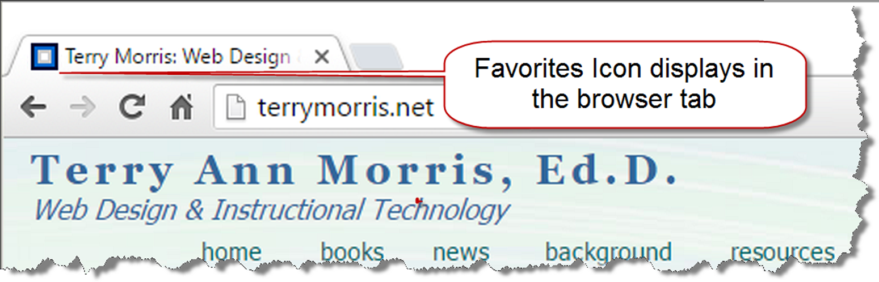
Figure 4.30 The favorites icon displays in the browser tab and address bar

Slide 56
CSS Sprites
Sprite –
an image file that contains multiple small graphics that are configured as background images for various web page elements
Modern technique to optimize use of multiple icon or small images
Saves overhead by reducing the number of http requests made by the browser.
You’ll use CSS Sprites in Chapter 7!

Slide 57
Sources for Graphics (1 of 2)
Create them yourself using a graphics application:
GIMP
Adobe Photoshop
Adobe Fireworks
Download graphics from a free site
Purchase/download professional-quality graphics
Purchase a graphics collection on a CD

Slide 58
Sources for Graphics (2 of 2)
Take digital photographs
Scan your photographs
Scan your drawings
Hire a graphic designer to create graphics

Slide 59
Guidelines for Using Images
Reuse images
Consider image file size with image quality
Consider image load time
Use appropriate resolution
Specify dimensions
Be aware of brightness and contrast

Slide 60
Images and Accessibility
Don’t rely on color alone.
Some visitors may have color perception deficiencies. Use high contrast between background and text color.
Provide a text equivalent for non-text elements.
Use the alt attribute on your image elements
If your site navigation uses image links, provide simple text links at the bottom of the page.

Slide 61
Checkpoint 4.3 (1 of 2)
Search for a site that uses image links to provide navigation. List the URL of the page.
What colors are used on the image links?
If the image links contain text, is there good contrast between the background color and letters on the image links?
Would the page be accessible to a visitor who is sight- challenged?

Slide 62
Checkpoint 4.3 (2 of 2)
How have accessibility issues been addressed?
Is the alt attribute used to describe the image link?
Is there a row of text links in the footer section of the page?
Answer the questions above and discuss your findings.

Slide 63
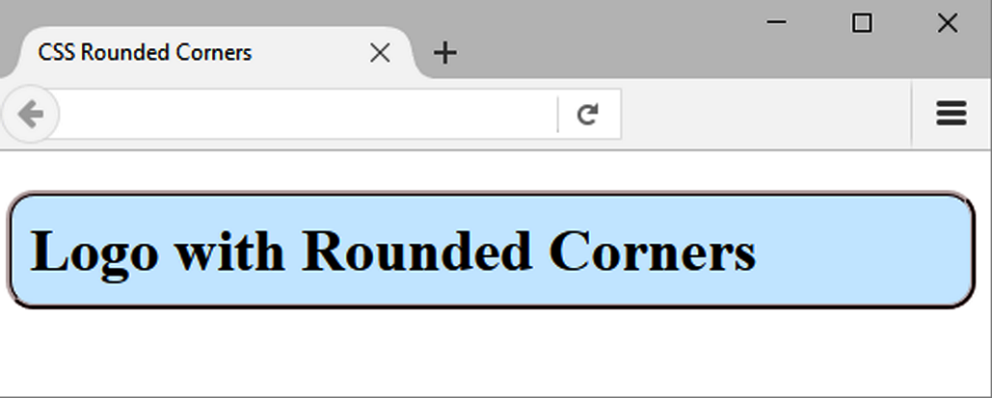
CSS Rounded Corners
border-radius property
Configures the horizontal radius and vertical radius of the corner
Numeric value(s) with unit (pixel or em) or percentage
Example h1 { border-radius: 15px;
}
Figure 4.32 Rounded corners were
configured with CSS

Slide 64
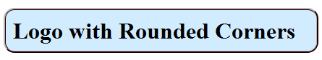

Examples of Rounded Corners
One value for border-radius configures all four corners Example: border-radius: 15px;
Four values for border-radius configure each corner separately Ordered by top left, top right, bottom right, bottom left Example:
border-radius: 15px 30px 100px 5px;

Slide 65
CSS box-shadow Property
Configure the horizontal offset, vertical offset, blur radius, and valid color value
Example:
#wrapper { box-shadow: 5px 5px 5px #828282; }
Optional keyword: inset

Slide 66
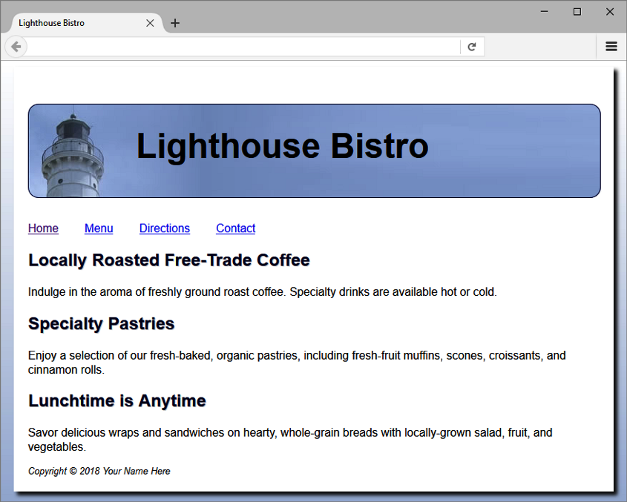
Figure 4.35 The centered neutral background along with shadow properties add dimension

Slide 67
CSS opacity Property
Configure the transparency of the element
Opacity range:
0 Completely Transparent
1 Completely Opaque horizontal offset, vertical offset, blur radius, and valid color value
Example:
h1{ background-color: #FFFFFF;
opacity: 0.6; }

Slide 68
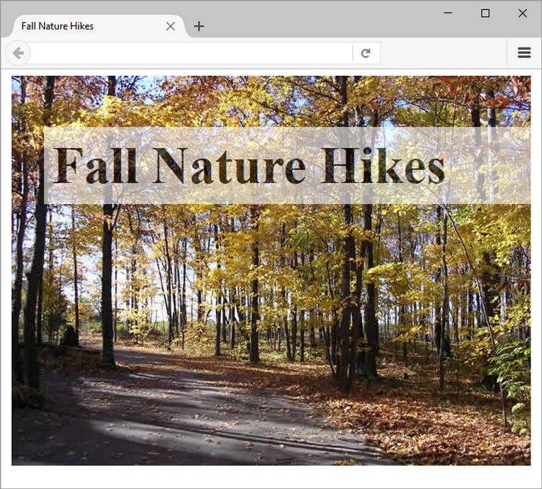
Figure 4.37 The background of the h1 area is transparent

Slide 69
Rgba Color (1 of 2)
Four values are required:
red color, green color, blue color, and alpha(transparency)
The values for red, green, and blue must be decimal values from 0 to 255.
The alpha value must be a number between 0 (transparent) and 1 (opaque).

Slide 70
Rgba Color (2 of 2)
Example:
h1 { color: #ffffff;
color: rgba(255, 255, 255, 0.7);
font-size: 5em; padding-right: 10px;
text-align: right; font-family: Verdana, Helvetica, sans-serif;
}

Slide 71
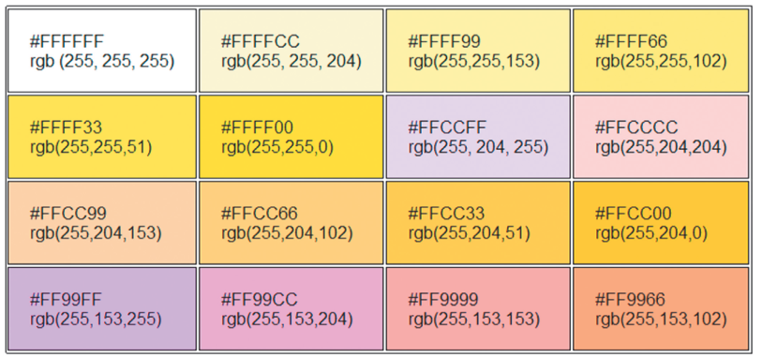
Figure 4.38 Hexadecimal and RGB decimal color values

Slide 72
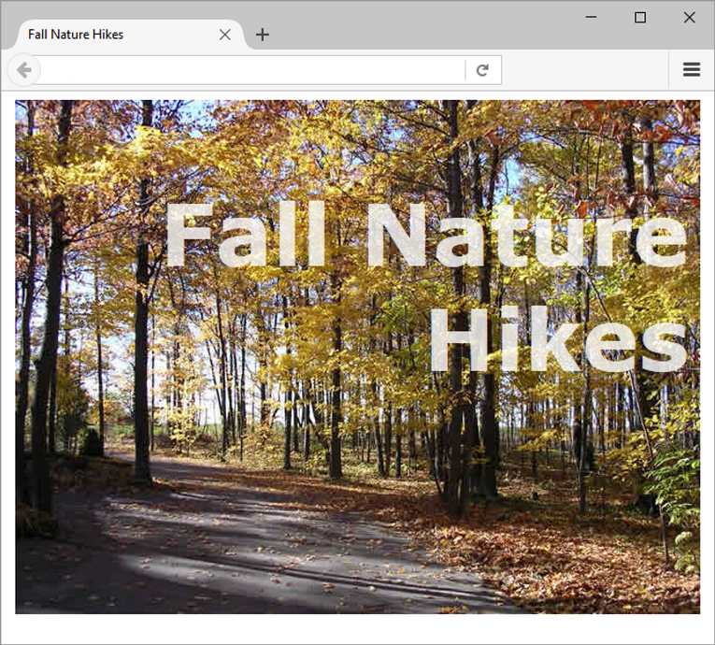
Figure 4.39 CSS RGBA color configures the transparent text

Slide 73
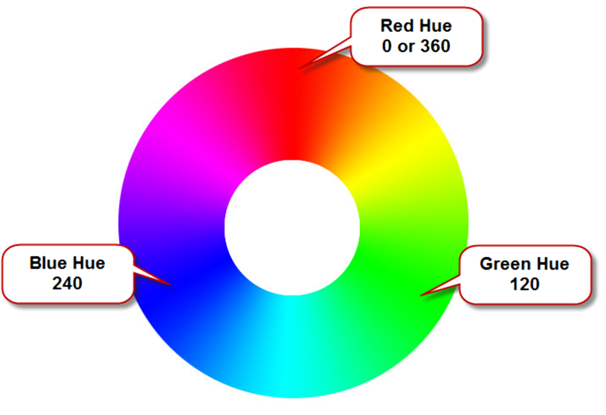
HSLA Color
hue, saturation, light, alpha
Hue is a value between 0 and 360
Saturation: percent
Lightness: percent
Optional alpha: from 0 to 1
Figure 4.40 A color wheel

Slide 74
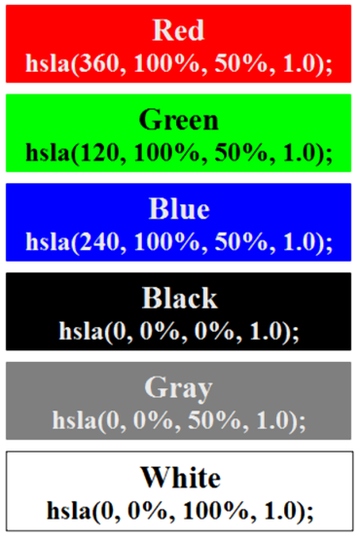
Figure 4.41 HSLA color examples

Slide 75
CSS Gradients
Gradient: a smooth blending of shades from one color to another
Use the background-image property
linear-gradient()
radial-gradient()
Example:
body {
background-color: #8FA5CE;
background-image: linear-gradient(#FFFFFF, #8FA5CE); }

Slide 76
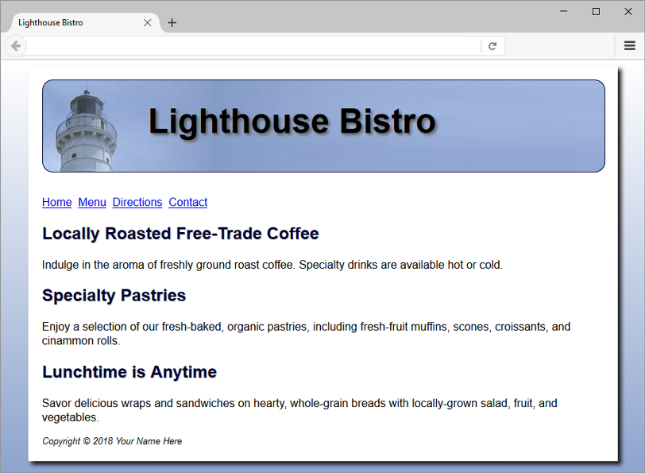
Figure 4.44 The gradient in the background was configured with CSS without an image file

Slide 77
Summary
This chapter introduced the use of visual elements and graphics on web pages.
As you continue to create web pages, look back at the guidelines and accessibility issues related to graphics.
The number one reason for visitors to leave web pages is too long of a download time. When using images, be careful to minimize this issue.
Provide alternatives to images (such as text links) and use the alt attribute on your pages.

